Slide 1

Milestone 1: Complete UI
Team members:
Badr Elsayed - 22010664
Adham Anas- 22010601
Mohamed Mostafa Sayed - 22011170
Nour Khaled Mohamed - 22011319
Ali El-Deen Maher - 22010934
Yousef Awad – 22011390

Slide 2
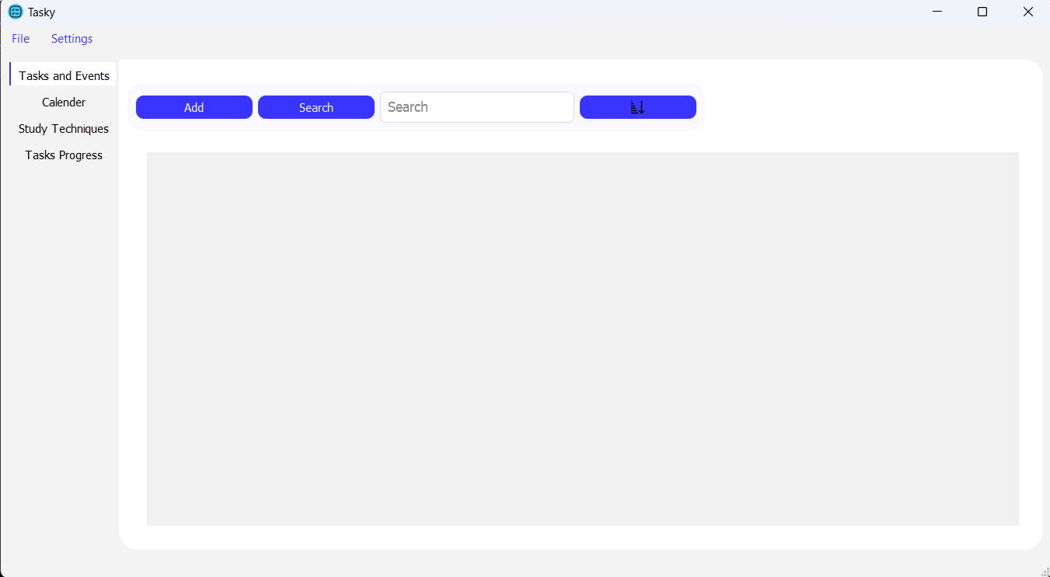
When we first open the app we see it has 4 tabs, and the first tab opened is called “Tasks and Events”, this is where we’ll see our tasks. We can start adding a task by clicking “Add”
Discussed Lastly

Slide 3
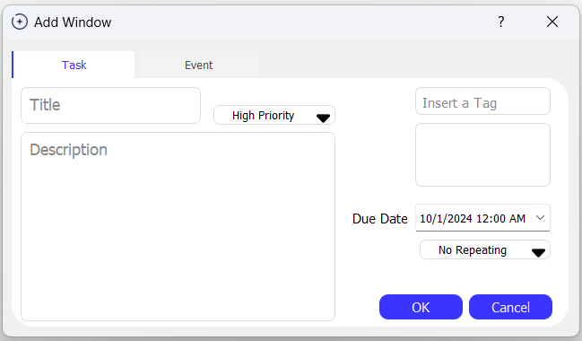
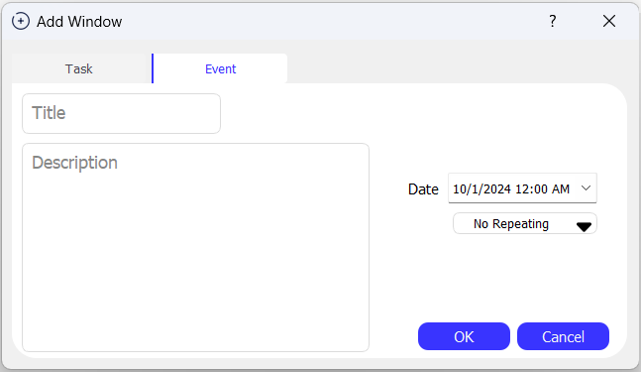
We’ll see a window open with 2 options, add a Task or add an Event. 1) Task: Most options are self explanatory. Tags are helpful when Searching. Priority is an indicator system for both visualization and sorting, as we’ll see in next slide. Tasks can be viewed in the Calender tab as well. 2) Event: A simpler version of a Task that appear only in the Calendar tab

Slide 4
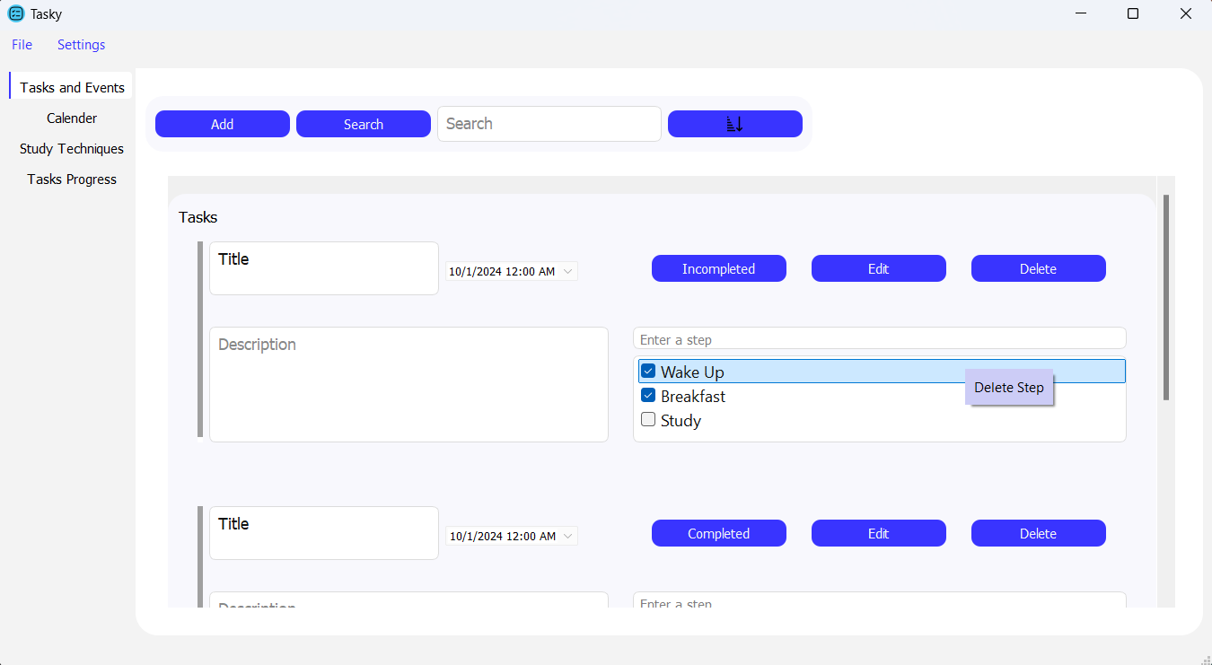
Added tasks will appear as shown, we can Search by Title or Tag. We have 2 sorting modes, sort by Due Dates (nearest to furthest) or sort by Priority (High to Low) and in each Priority, tasks are sorted by Due Dates. Priority Bar will have different colors based on what priority or if the task is marked as Completed
Sort
Switchable button
Priority Bar

Slide 5
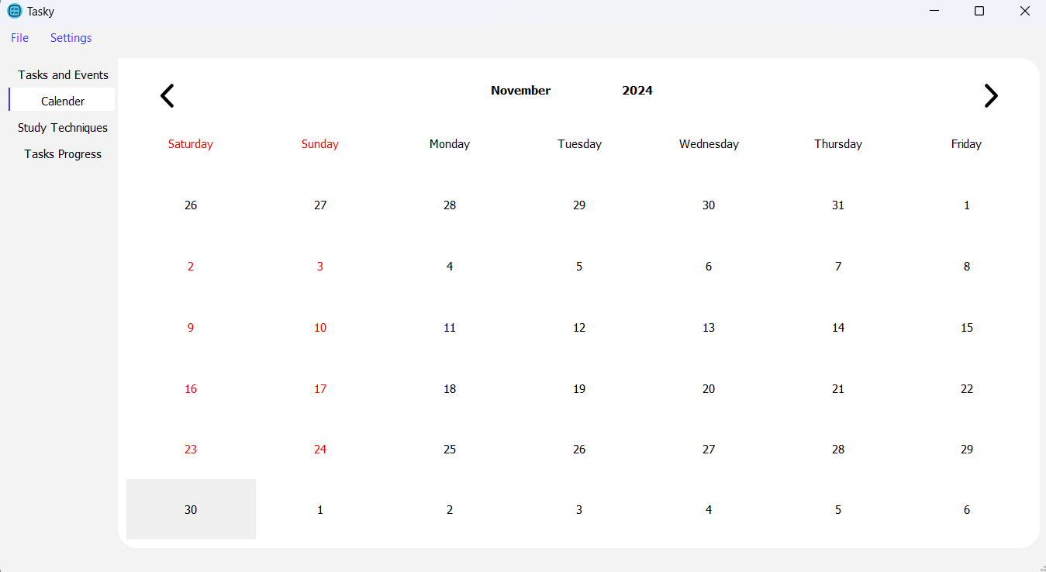
Tab Calender is a simple calender that will show the day of Due Date of a task or event, each with a different color. When clicking a day it will show a tooltip with the information of the task/event

Slide 6
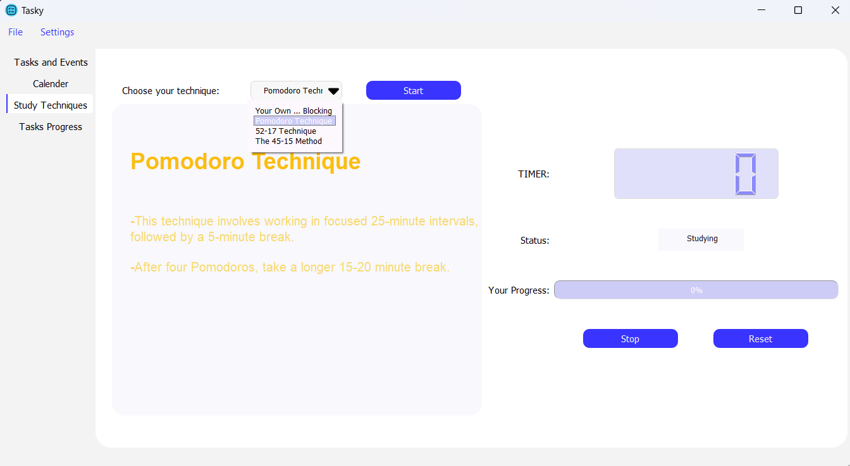
Tab Study Techniques is a tab to help focus on studying or any form of focus requiring work. It’s as follow: -When clicking Start, it’ll start a timer for you to study. -When the time ends it’s time to take a break so it’ll switch to a different timer. And so on. There are different study techniques, each with different study and break time. You can even set your own.

Slide 7
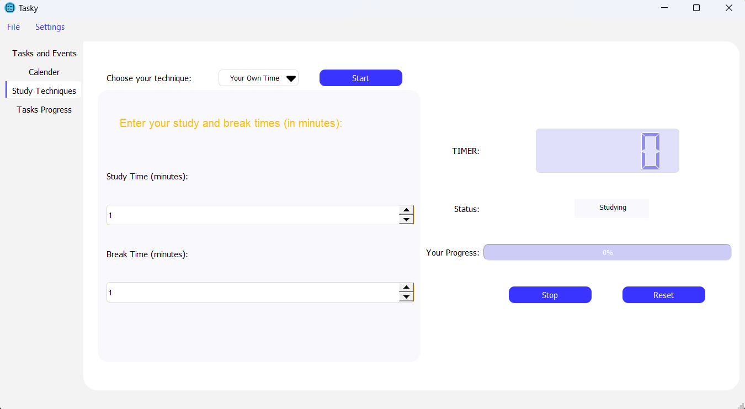

Slide 8
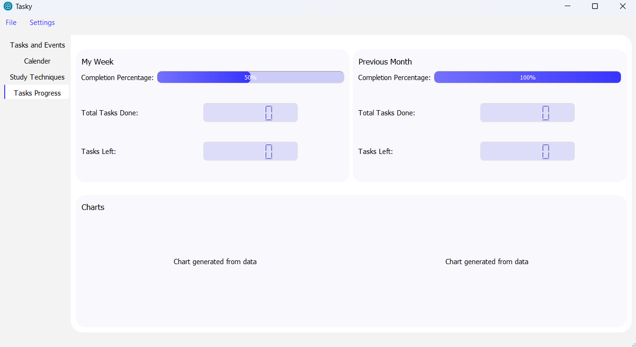
Last Tab Tasks Progress, self explanatory. Charts are yet to be decided upon.

Slide 9
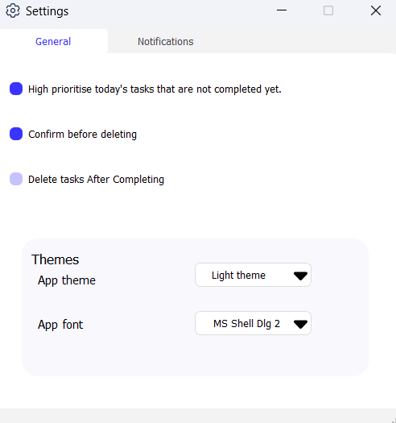
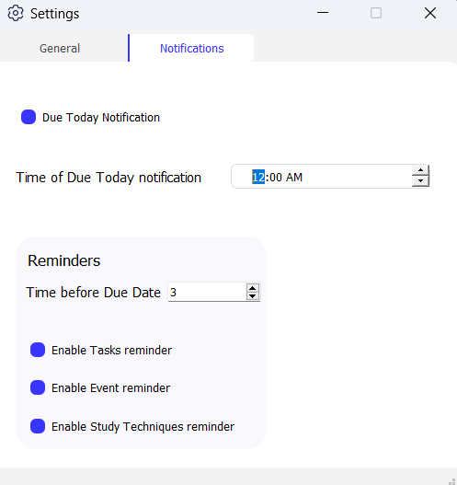
The Settings Window: General: Most are self explanatory. App theme makes you change between Light and Dark modes, App font lets you change the font of the app. Notifications: Are explained in the bubbles.
Set a time for a notification on the task’s due day.
Set a reminder to remind you before a task’s due date (in hours)
Enable/Disable the above reminder
Enable/Disable the above reminder
Reminds you if the app is minimized and timer is up.

Slide 10
